Slide 1
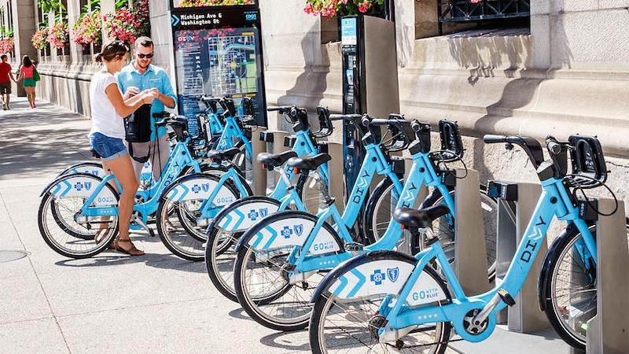
Cyclistic Data Study
By Justin Cavanaugh

Slide 2
Table of Contents
01 Title Page
02 Table of Contents
03 About Cyclistic
04 Cyclistic Pricing Model
05 Goals of the Data Study
06 Data Limitations
07-12 Casuals vs Members Visualizations
13-15 Station Popularity
16-18 Conclusions
19 Appendix

Slide 3
About Cyclistic
Cyclistic is a fictional company based off the Chicago based bike-sharing company Divvy bikes.
Cyclistic has 5,824 scattered throughout 692 bike stations in Chicago. These bikes can be unlocked and returned at any other station.
There are two types of Cyclistic users: casuals and members. Casuals are bikers that buy 1 ride/full day passes and members have annual passes.

Slide 4
Cyclistic Pricing Model
Casual Riders
Members
Bike Type | Single Ride $1 + x/min | Day Pass $16.50/day | Annual Pass $130.90/year
Classic Bike | $1 unlock + $.17/min | 3 hours free, then $.17/min | 45 min free, then $.17/min
Electric Bike | $1 unlock + $.42/min | Free unlocks + $.42/min | Free unlocks + $.17/min
Consumer Benefits
Single Ride: Great for short trips (<1.5 hours) on classic bike, and electric bike.
Day Pass: Only beneficial if using classic bike for >1.5 hours. If only using an electric bike, single ride passes are better unless making absurd number of rides (17+).
Annual Pass: Amazing value for short daily use of classic bike. Great discount on electric bike which breaks even with single ride price around 9-10 hours of use(for the year).

Slide 5
Goals of the Data Study
Moreno believes that maximizing the number of annual members will be the key to future growth. She notes that casual riders are already aware of the membership program.
The Cyclistic marketing team led by Lily Moreno is aiming to convert casual riders to members.
Analyzing the past 12 months of data should help us discover how casual bikers and members differ in their bike usage.

Slide 6
Data Limitations
There is no distinction in the data for casual bikers that purchase a single ride pass vs a day pass.
Many data points are missing the start and end stations.
For bike type, the category “docked_bike” is seemingly incomplete. This bike type isn’t found on Divvy’s pricing model so this bike type will be ignored.

Slide 7
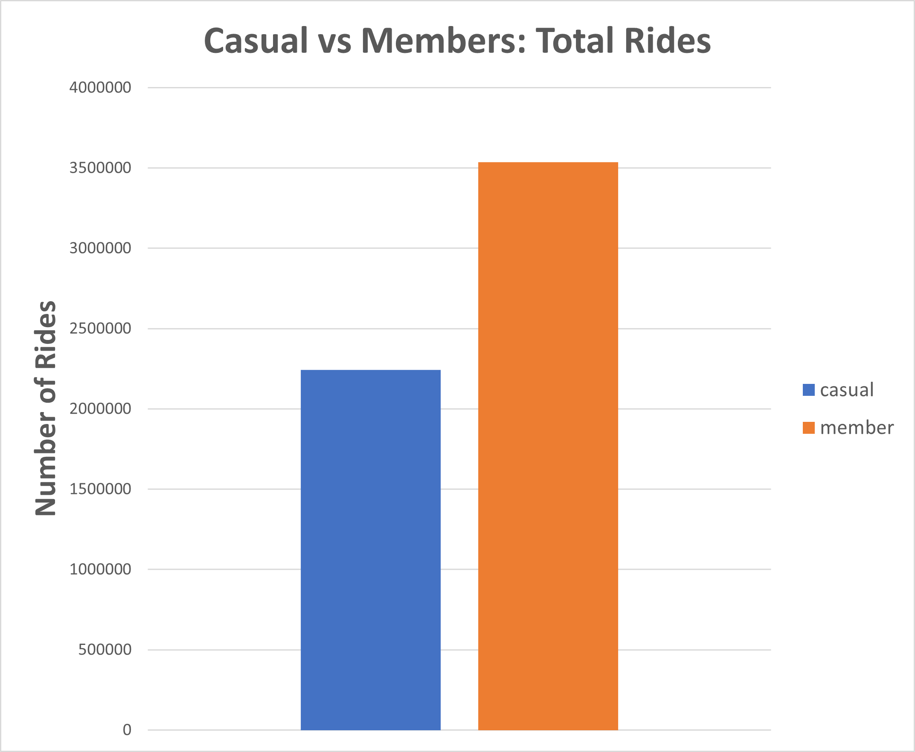
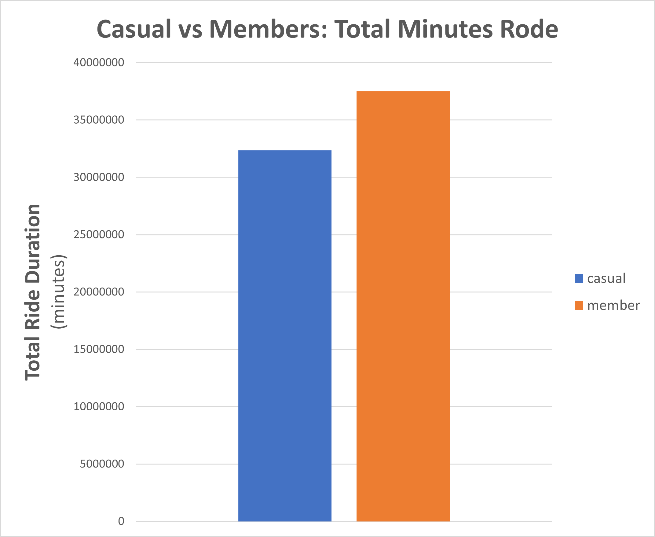
Casual vs Members: One Year of Data
While members make up 61.2% of bike rides, they only make up 53.7% of total minutes rode
This concludes that casual bikers have a longer average bike ride

Slide 8
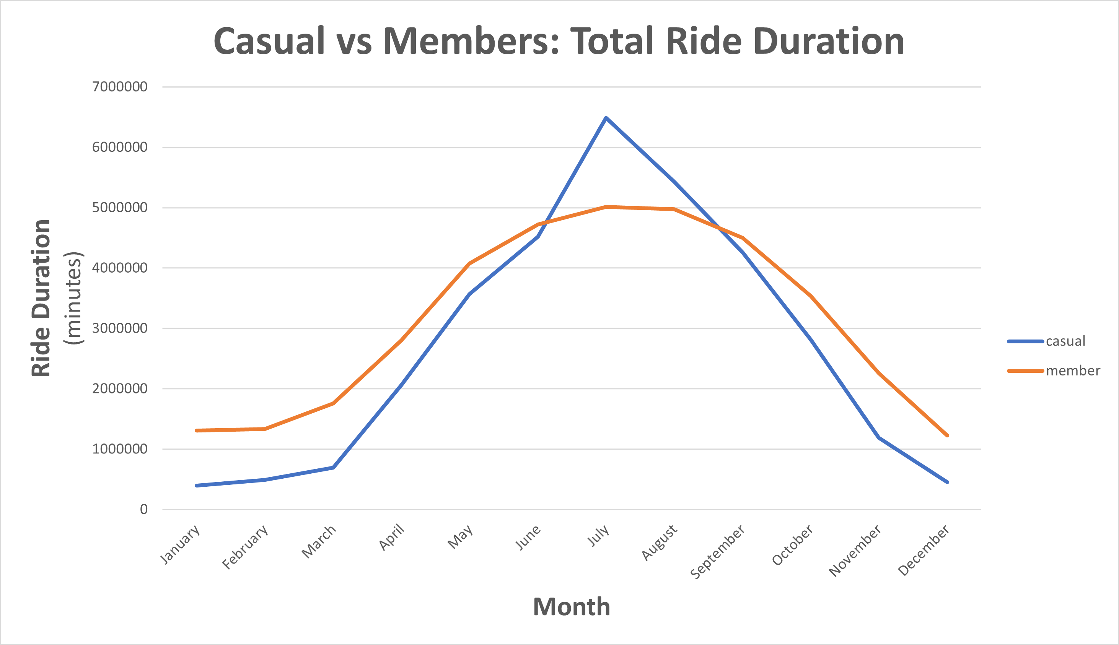
Casual vs Members: Total Minutes Rode by Month
Casual bikers total ride times exceeds that of members during the summer.
Do casual bikers outnumber members during the summer or are they travelling further?

Slide 9
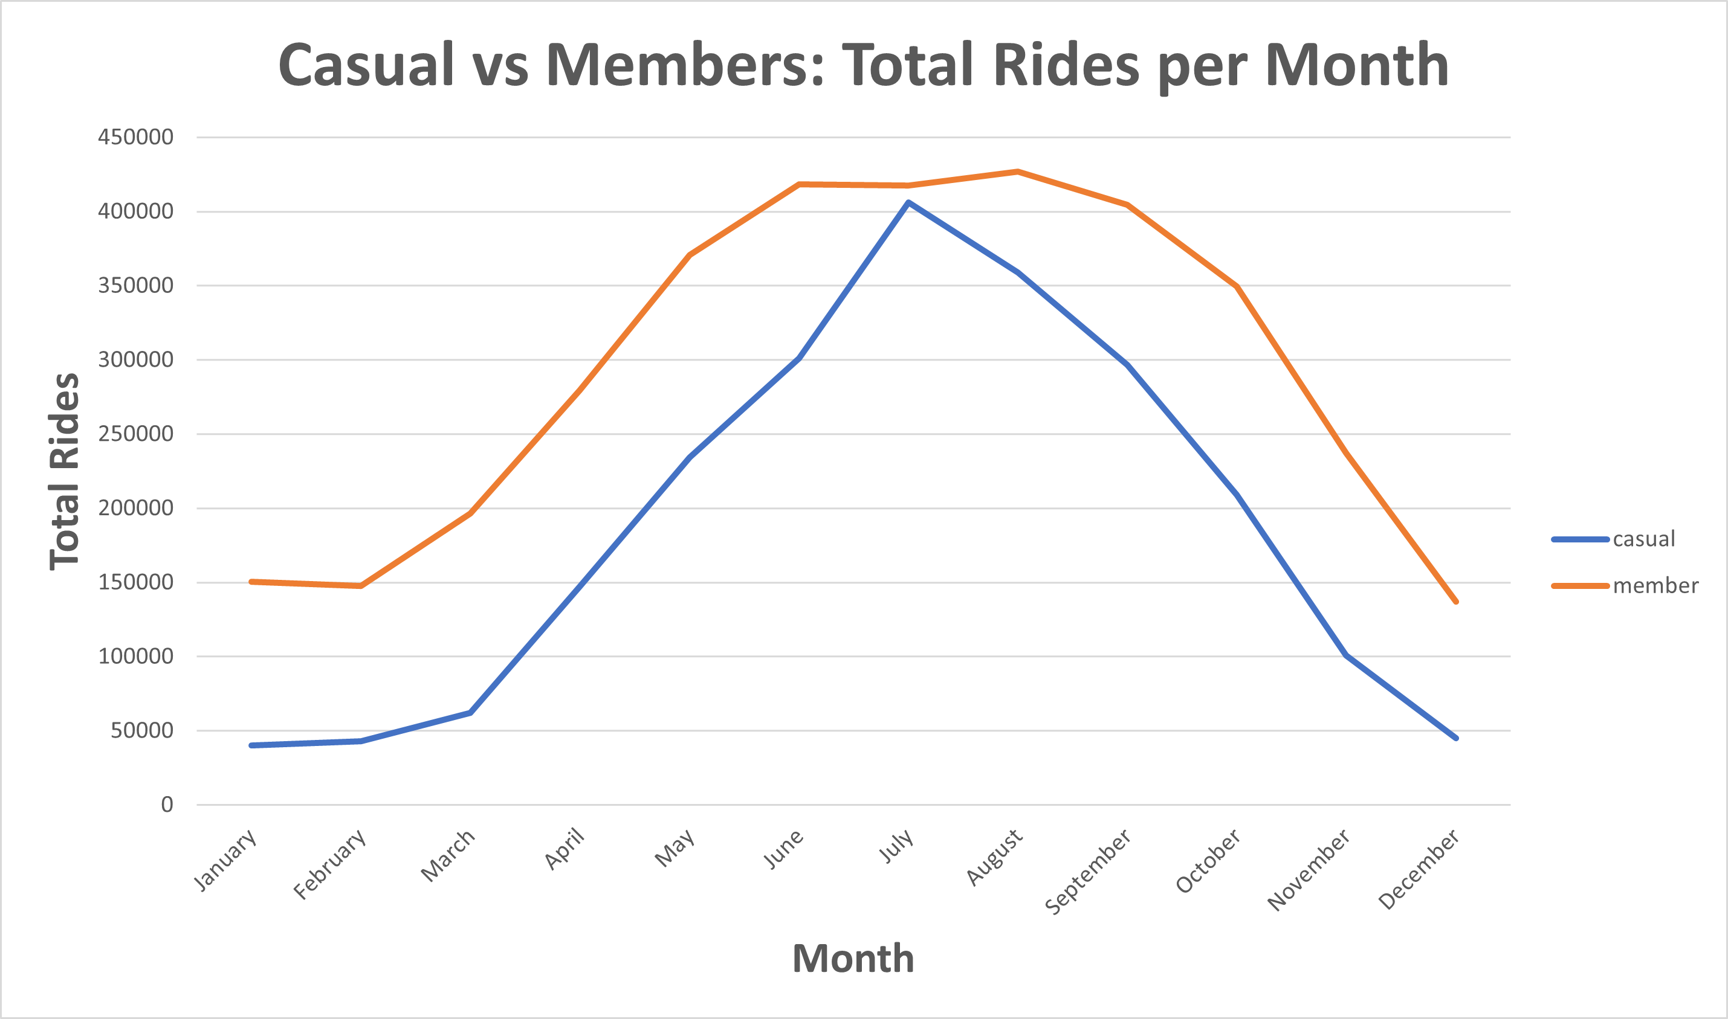
Members Outnumber Casual Bikers
Members total more rides per month than casual bikers, but the totals are close during the summer.
The summer season is significantly more popular for both types of bikers than other seasons.
People are less likely to use bikes during the cold Chicago winters.

Slide 10
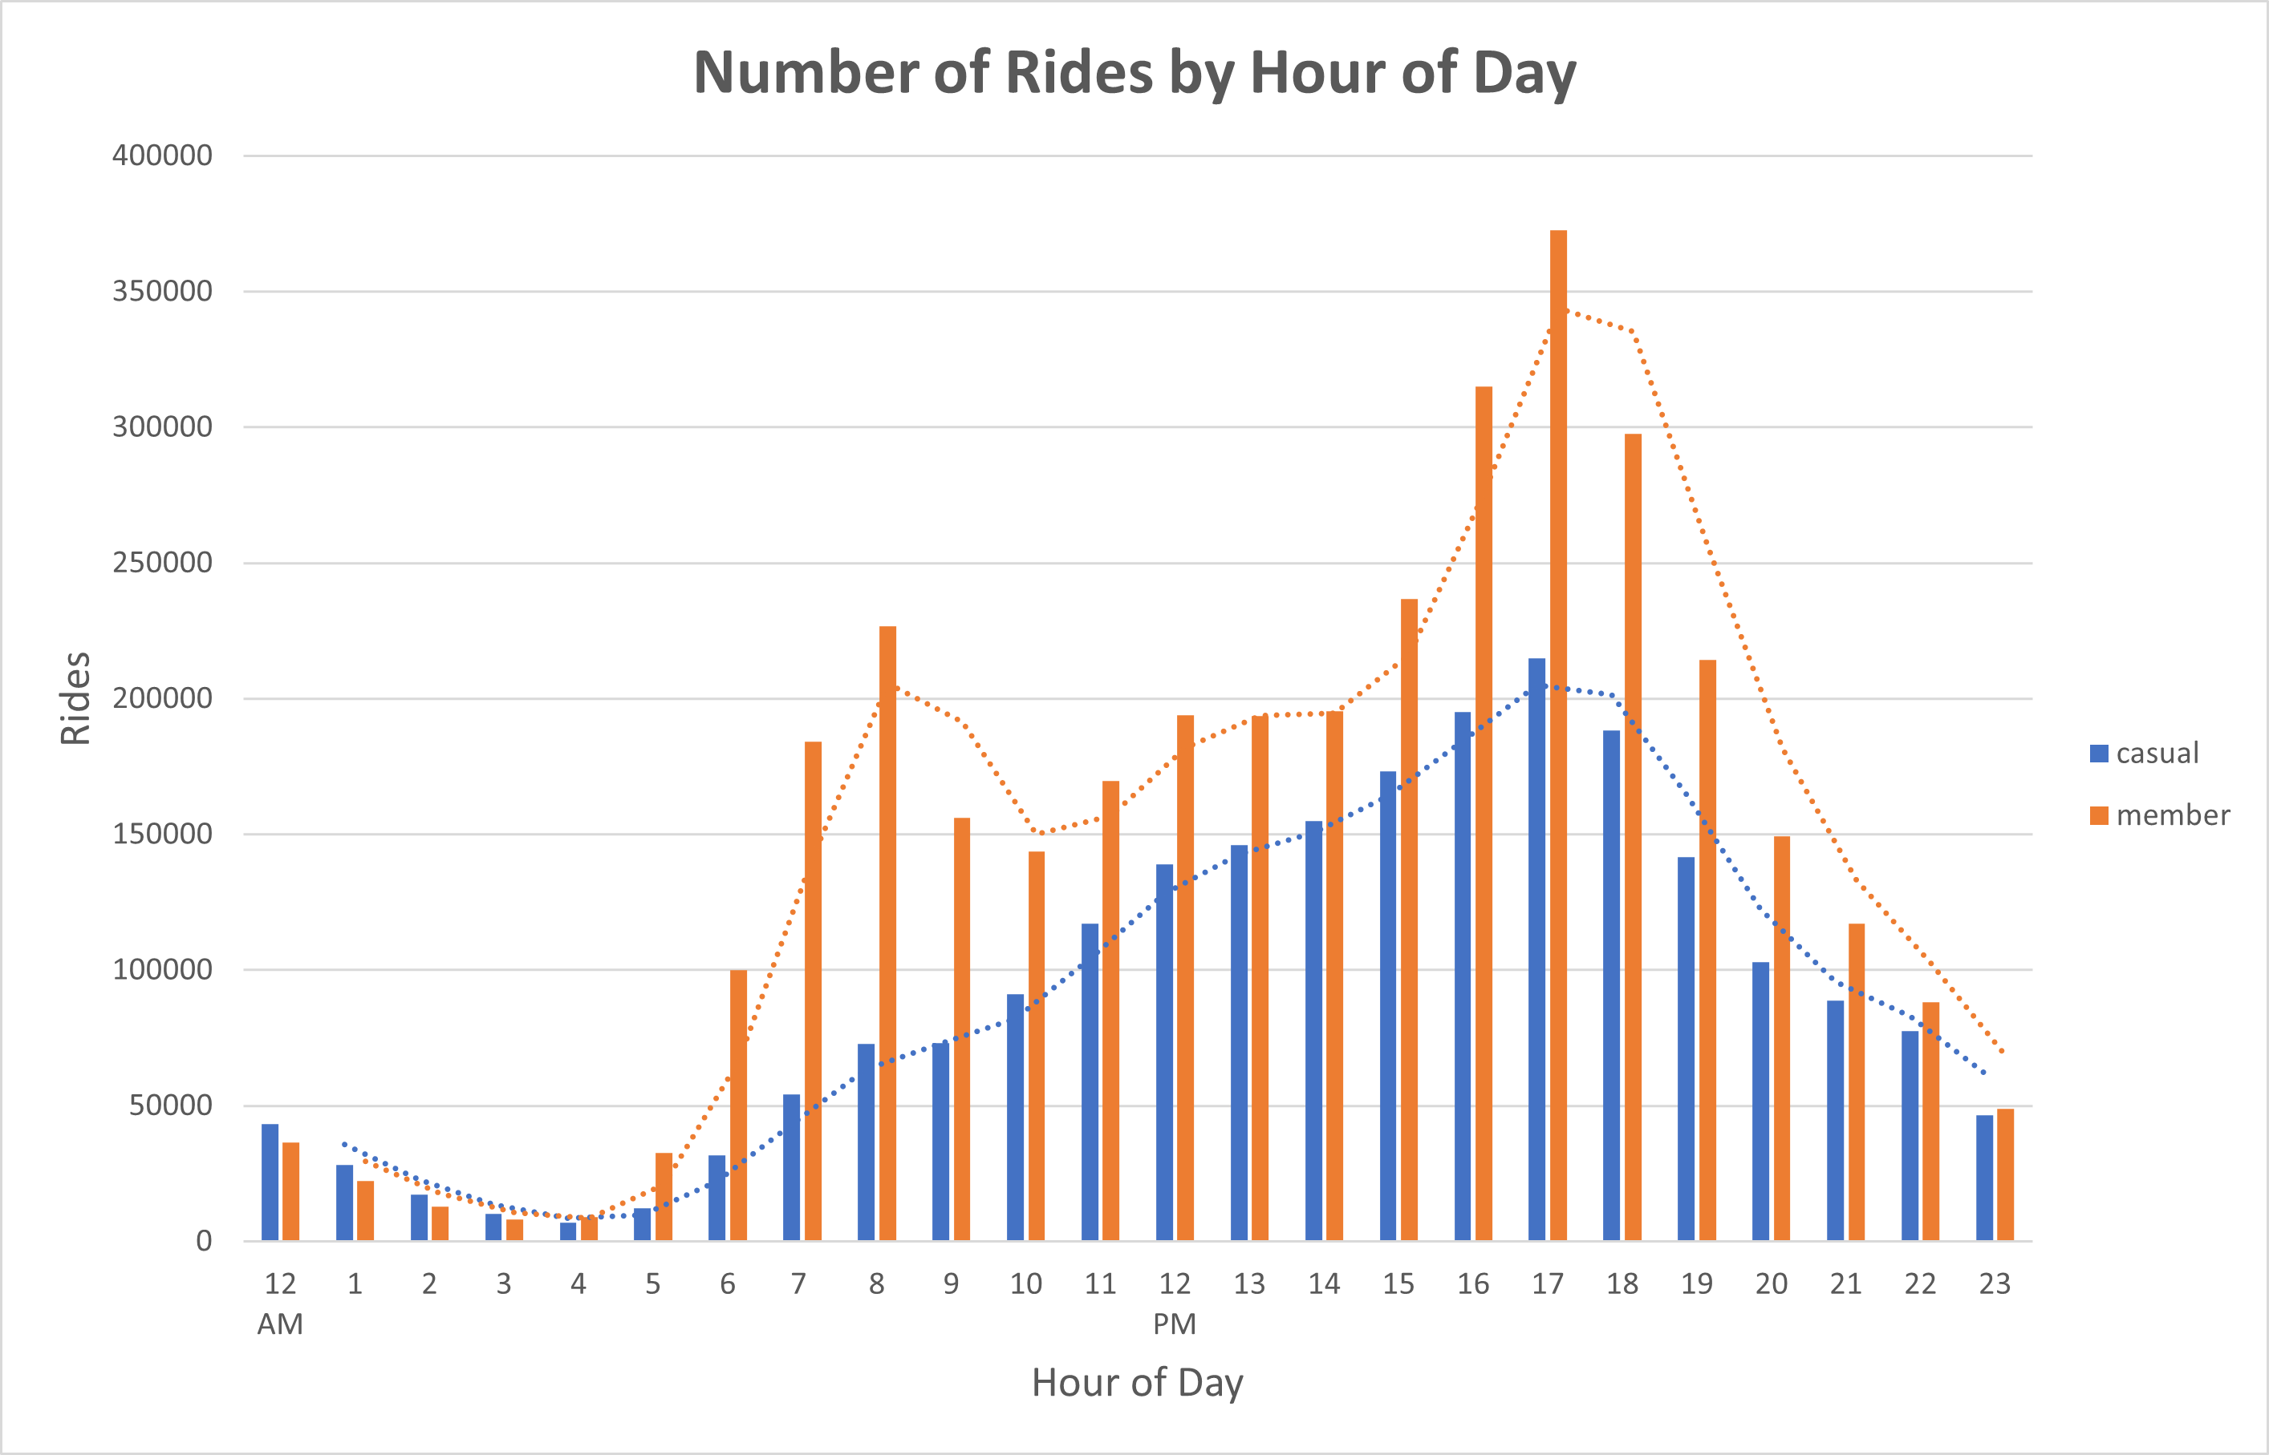
What time of day are bikes used most?
Casual member bike usage looks regular, with peak usage at 5 PM.
Members however show huge spikes of bike usage at 7-8 AM and 4-6 PM.
Members are regular users, meaning the spikes are likely due to those commuting to and from work.

Slide 11
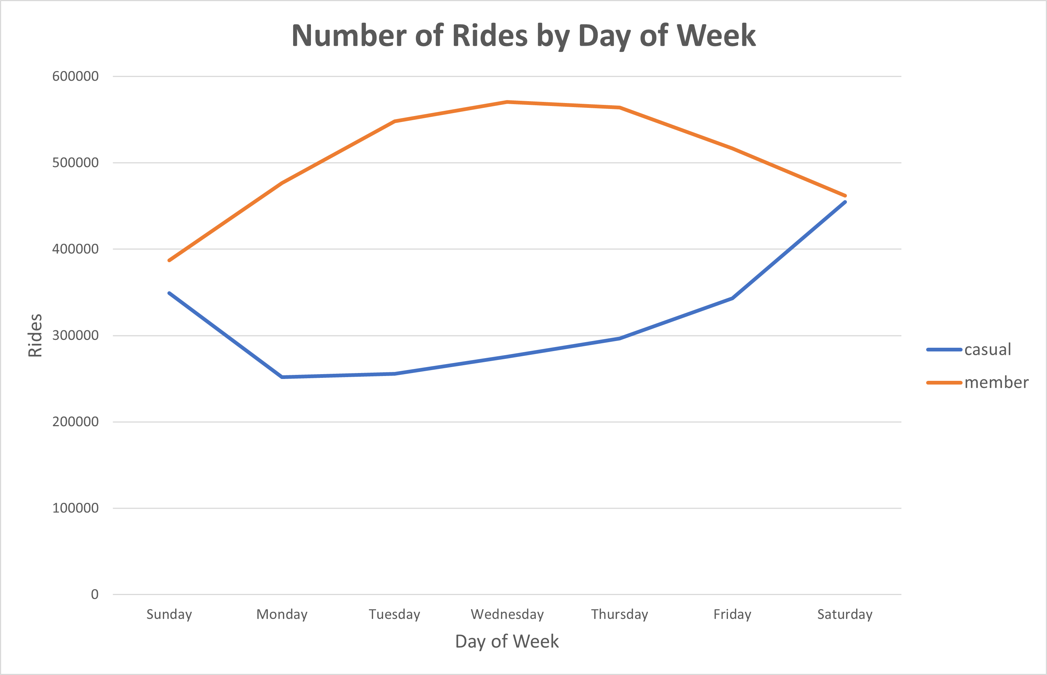
What days are most popular for bikers?
Member bike usage is lowest on weekends, the opposite for casual bikers.
This supports the idea that members are using the bikes to commute during the workweek.
We know casual bikers aren’t commuting daily, so we would like to find out patterns on their bike usage.

Slide 12
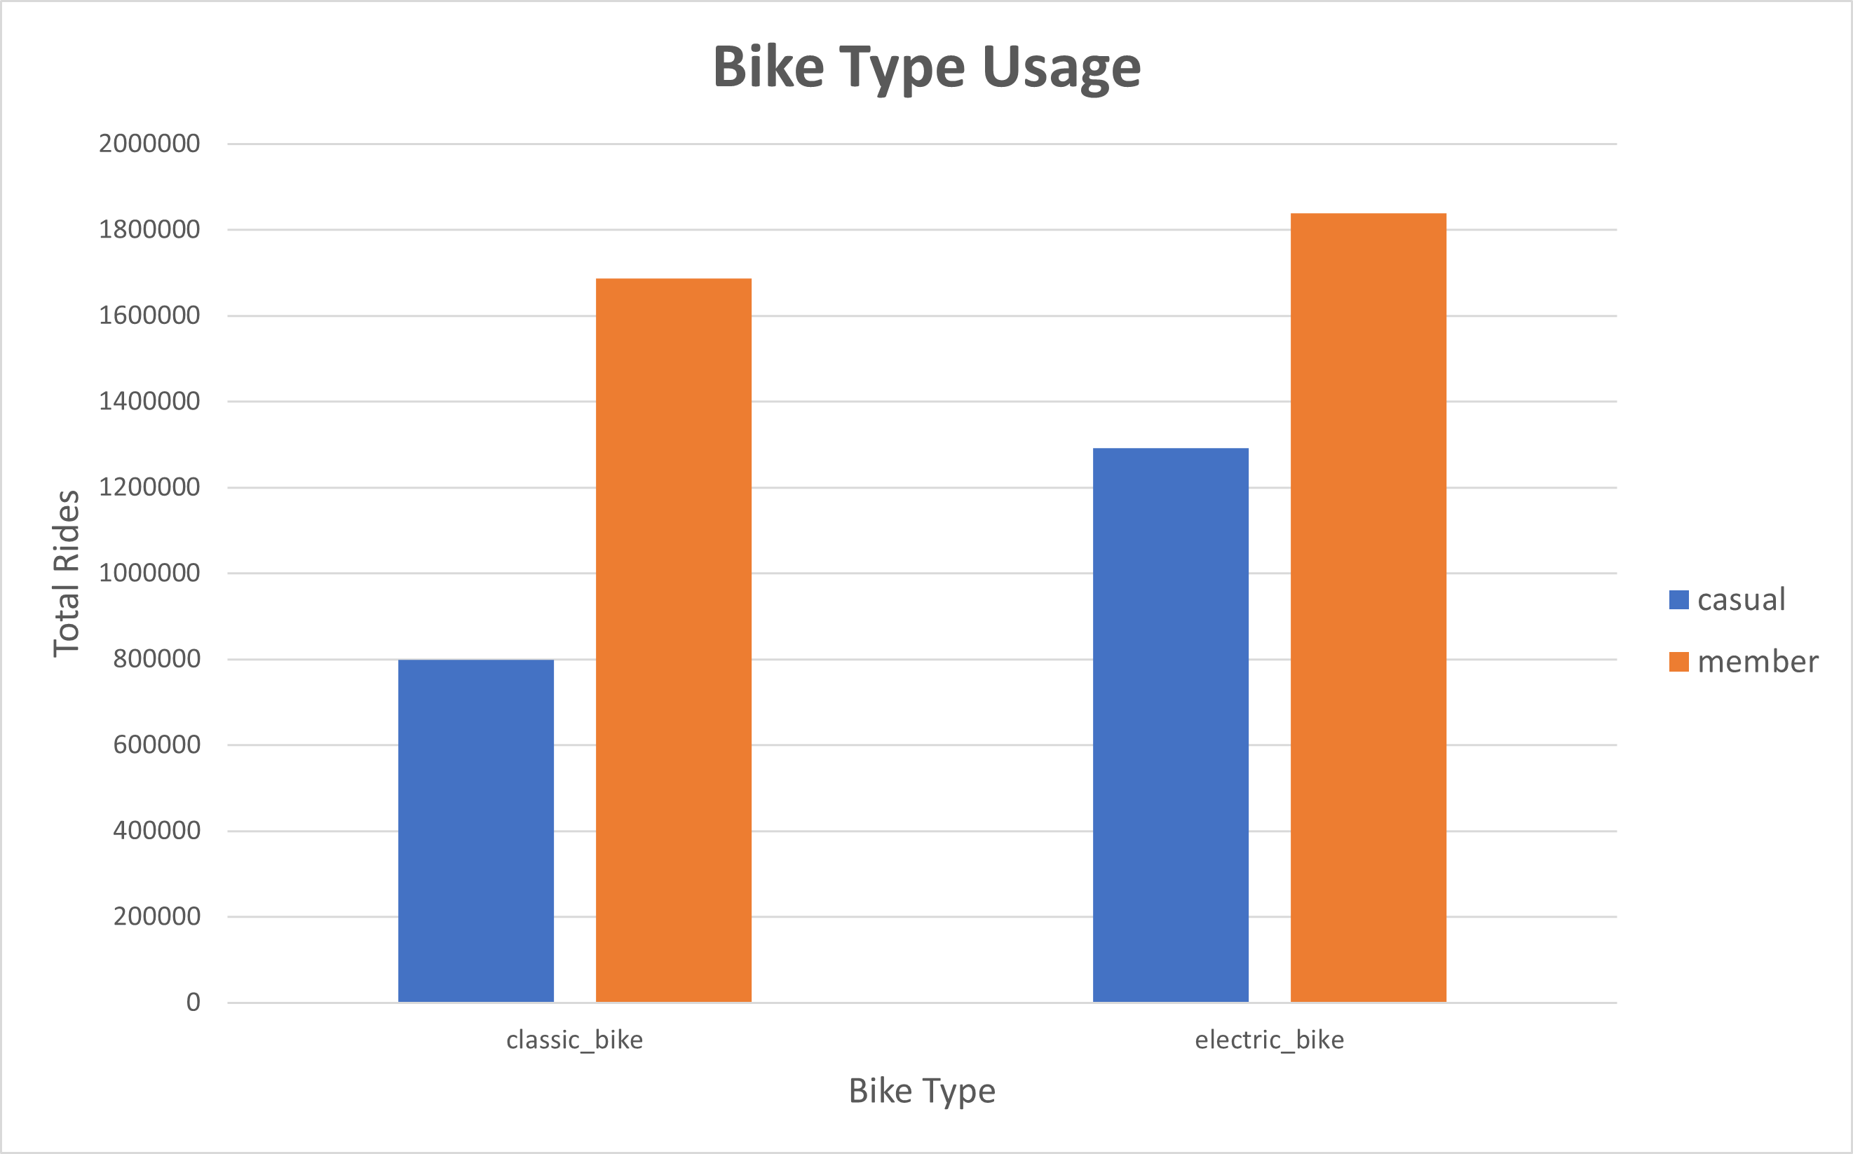
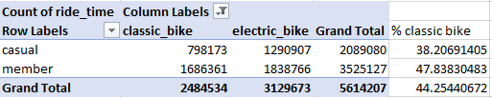
Members vs Casuals: Bike Type Usage
Both types of users prefer the electric bikes.
Casual bikers use the classic bike 38.2% of the time while members are up to 47.8%.
This significant difference can likely be explained by the pricing model that gives members 45 minutes free daily on the classic bike.

Slide 13
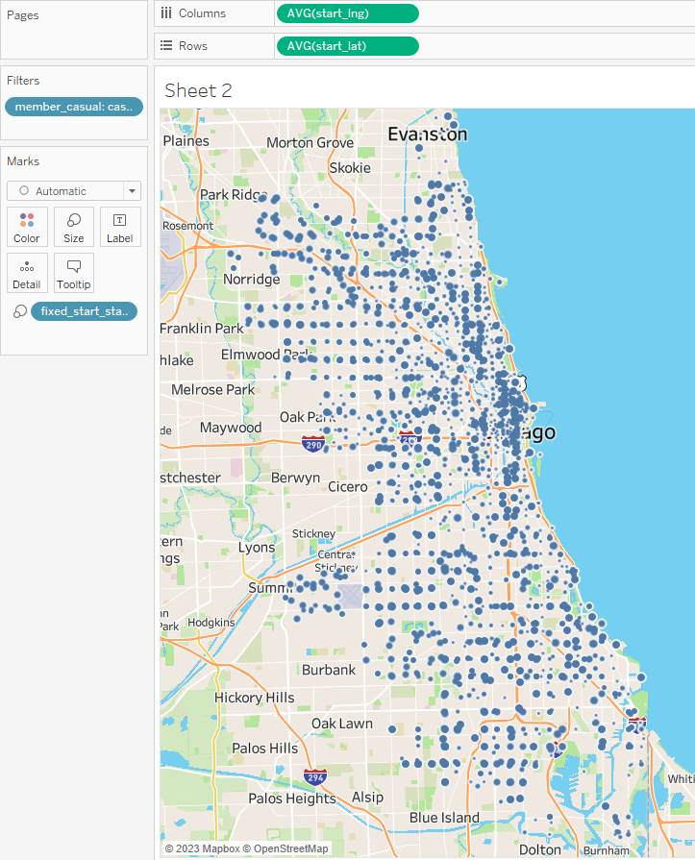
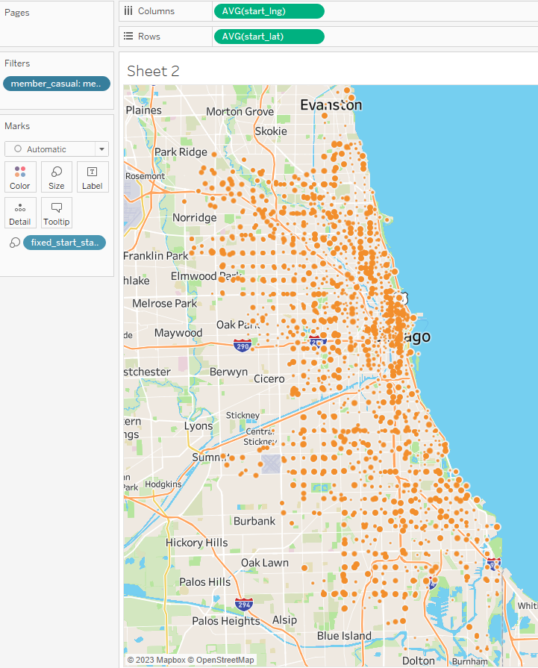
MAPPING START STATIONS
The following visuals are maps of the starting locations for both user types. The larger the circle, the more rides started at the station.
The main message to be obtained from these graphics is that the stations in downtown Chicago are popular for both users.
Casuals
Members

Slide 14
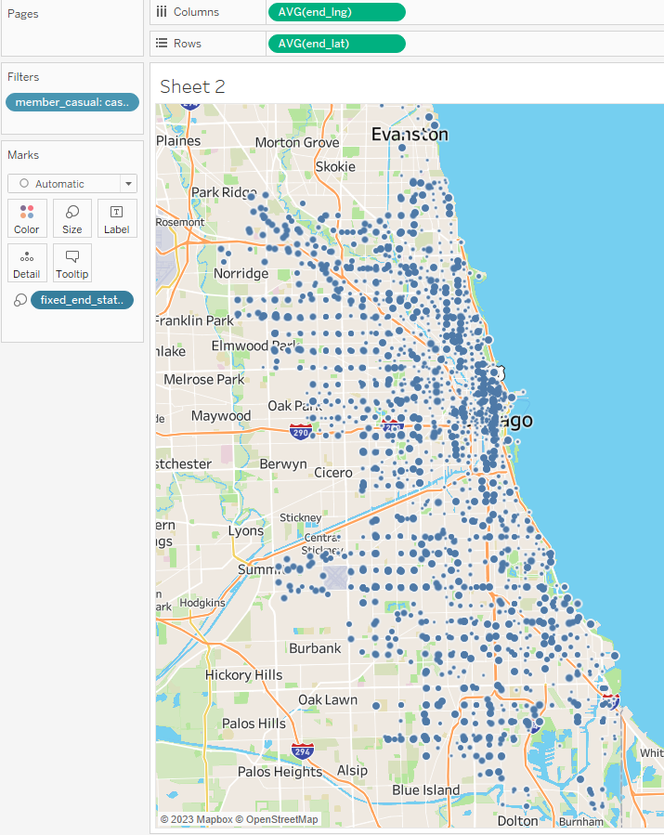
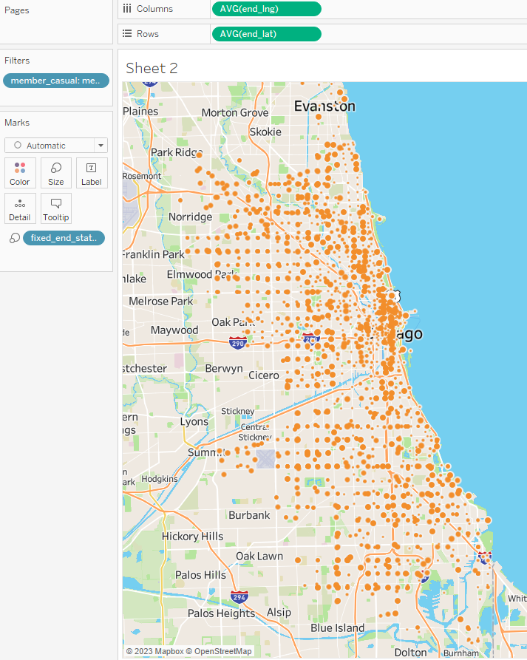
Mapping the End Locations
Mapping the end locations gives similar results to the start locations.
Compared to the start locations, the end locations aren’t too different.
We will want to look at a list of the top stations to get a concrete idea of which stations should be prioritized.
Casuals
Members

Slide 15
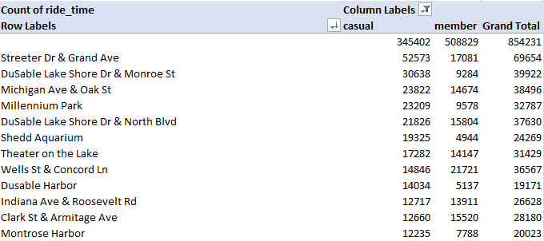
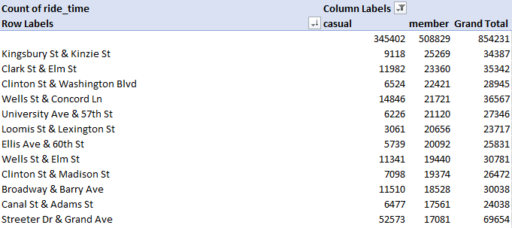




























Observing the Most Popular Stations
The top chart displays the most popular stations for casuals, and the bottom chart displays the most popular stations for members.
Members total up many more rides but the highest peaks for popular stations belongs to casual riders. This is due to casuals mainly using bikes for leisure, as the most popular stations are in downtown Chicago.
Members have a more even spread of stations relative to the total rides. This can be explained by many members using Cyclistic for commuting purposes.

Slide 16
Main Takeaways
Winter months are significantly less popular for both user types.
Member bike usage has lots of commuters, while the casual bike usage peaks on Friday and weekends.
Electric bikes are preferred by both user types, but classic bikes are still popular for members likely due to the pricing plan.
Members have a shorter average ride time than casual bikers.

Slide 17
Converting Casual Bikers into Members
The three preferences of casual riders that we can target are: longer ride times, weekend priority, and electric bike priority.
Creating a rewards program for members that gives extra incentives to those who travel long distances or use Cyclistic bikes on the weekends can encourage casual riders to consider the membership program.
An incentive such as reduced cost(or free) rides on the electric bike will benefit current members, but also encourage casuals to join the program.

Slide 18
General Suggestions
Giving incentive to bikers to use the program during the winter can help boost user count during the least popular season. Not everyone wants to ride every day in the winter, so giving rewards to those that ride at least 3-4 times a week in the winter can encourage riders to use the program during the cold months.
Ensuring that the most popular bike stations contain the proper distribution of classic and electric bikes is important. Stations popular for members should contain around 45% classic bikes, while stations popular for casuals should contain around 40% classic bikes. Ensuring that electric bikes are always available is important as they generate more income, but it’s important not to exclude the classic bike users by making classic bikes too scarce.

Slide 19
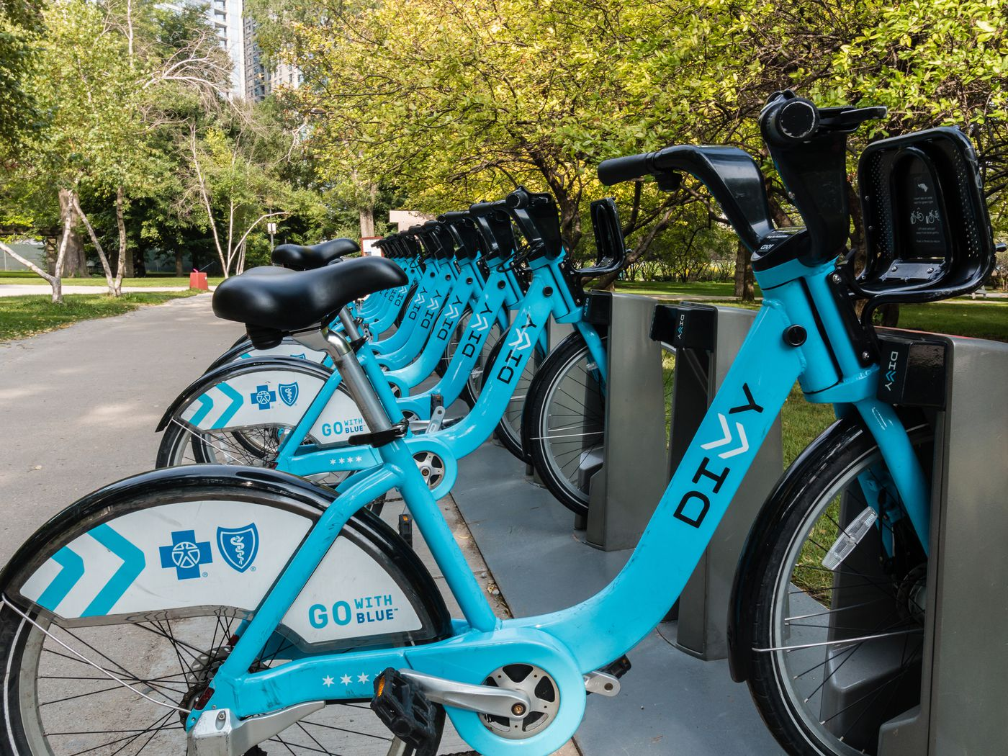
Appendix
Data License Agreement: https://ride.divvybikes.com/data-license-agreement
Divvy Pricing Model: https://divvybikes.com/pricing

